Slide 1



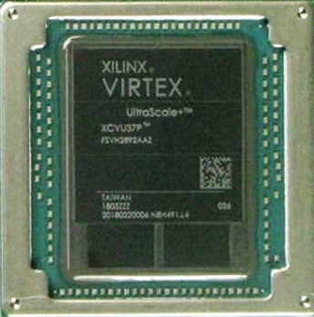
Reconfigurable Hierarchical Interconnectivity for Large-Scale
Neuromorphic Cognitive Computing
https://www.nsf.gov/awardsearch/showAward?AWD_ID=1823366
Omowuyi Olajide presenting for UCSD NSF-Camelot
April 3, 2022
"Reverse Engineering the Cognitive Brain"; G. Cauwenberghs, Proc. Nat. Acad. Sci. (PNAS), vol. 110 (39), pp. 15512-15513, 2013.

Slide 2

The Challenge: Capture Neural Dynamics in Silicon
for Real Time Emulation at Scale
To inspire new models for Brain Dynamics and Machine Learning
CRI FireFly Interconnect Option
https://www.nsf.gov/awardsearch/showAward?WD_ID=1823366

Slide 3
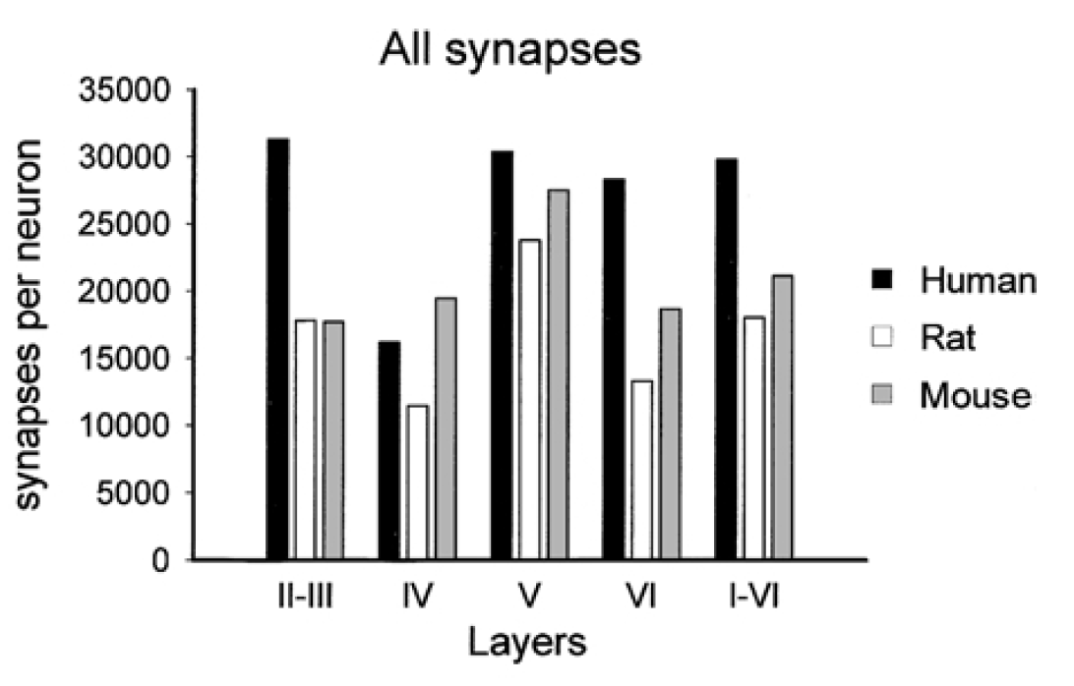
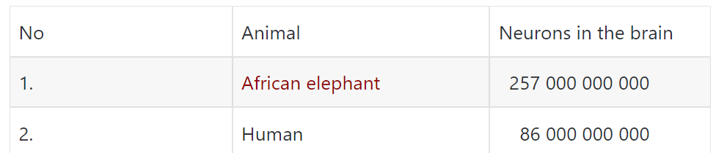
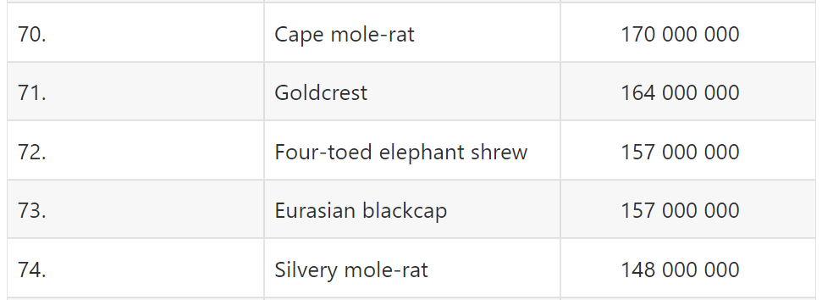
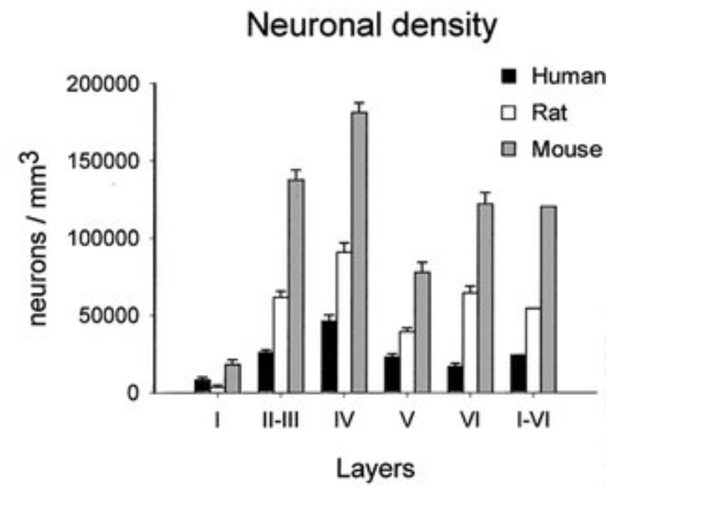
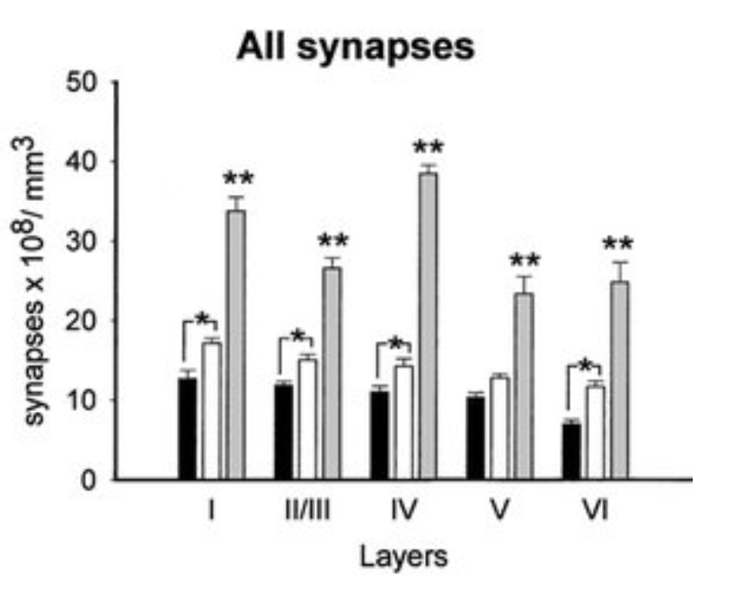
Our Goal 160M neurons and 40G Synapses
.
.
.
.
.
.
https://dinoanimals.com/animals/number-of-neurons-in-the-brain-of-animals/
Microstructure of the neocortex: Comparative aspects
Jon Arellano et al, Journal of Neurocytology · March 2002

Slide 4
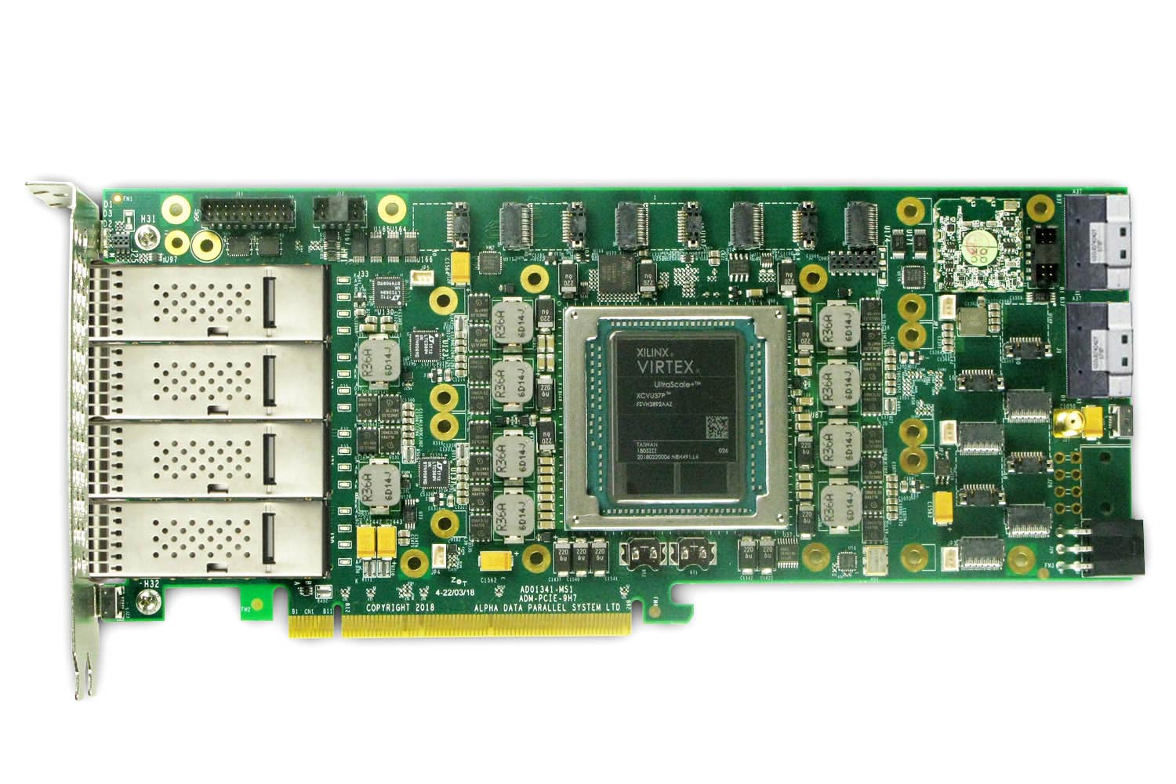
Alpha-Data ADM-PCIE-9H7
8 Firefly ports, 4 QSFP, 2 Slim SAS, PCIex16
4 QSFP28s, 8 Fireflys*, each 4 bidi lanes x 28Gbps/lane/dir (or 14, 16, 25 Gbps), 2 Slim SAS 100Gbps
* https://www.samtec.com/optics/optical-cable/mid-board/firefly
4

Slide 5
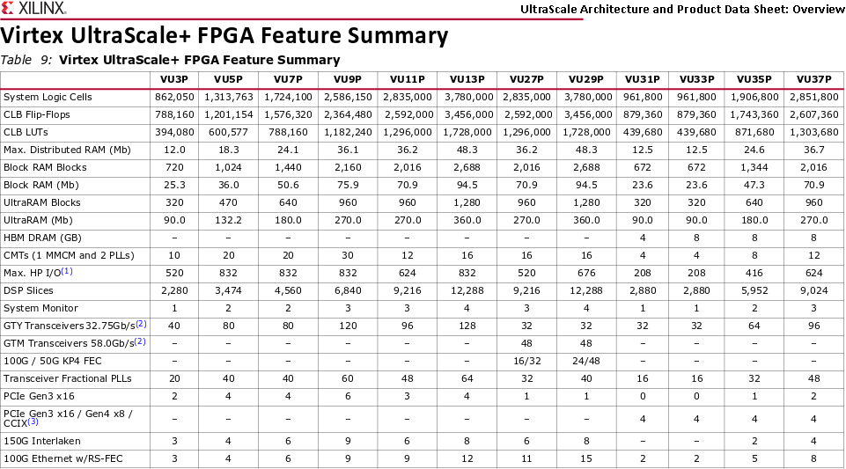
FPGA specifications
8
Source: https://www.xilinx.com/support/documentation/data_sheets/ds890-ultrascale-overview.pdf

Slide 6
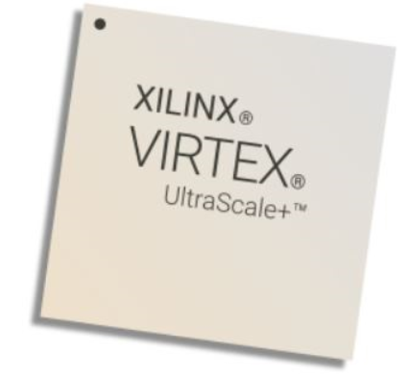
Xilinx VU37P: internal memory
Distributed RAM: up to 36.7 Mb
Block RAM (BRAM): 2,016 blocks of 36 kb = 70.9 Mb
Each block: 36 kb, dual-port
Possible configurations: 32K × 1; 16K × 2; 8K × 4; 4K × 9 (or 8);
2K × 18 (or 16); 1K × 36 (or 32); or 512 × 72 (or 64)
UltraRAM (URAM): 960 blocks of (4K × 72 bits) = 270 Mb
Each block: 288 kb, dual-port
Possible configurations: 4K × 72; or 4K × 64 (with ECC)
High Bandwidth Memory (HBM): 2 stacks × 4 GB = 8 GB
32 HBM AXI interfaces
Interfaces can access any address on either HBM stack
460 GB/s BW

Slide 7
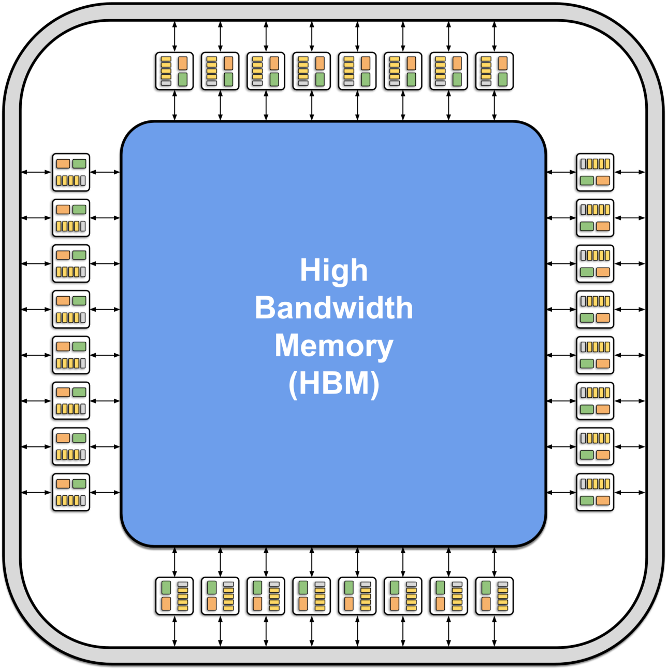
HBM–centric processing architecture
Processors
32 HBM AXI interfaces → 32 parallel processor cores
Neurons
4M neurons / 32 processors = 128K neurons / core
Synaptic Weight & Route Table memory
8 GB total HBM memory:
8 GB / 32 cores= 256 MB / core
256 MB / 32b = 64MB pointers and weights
64MB / 128K neurons = 512 pointers-weights/neuron
Neuron memory
960 URAM blocks:
960 blocks / 32 cores= 30 blocks / core
30 blocks = 120K × 72 bits = 8.64 Mb / core
8.64 Mb / 128K neurons = 67 bits / neuron
Routing memory (for off-core events)
BRAM used for FIFOs

Slide 8
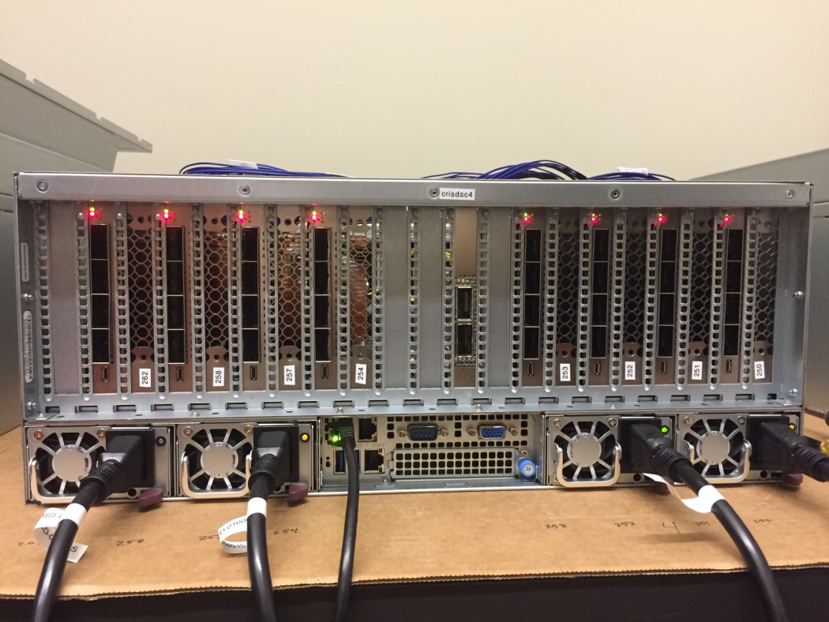
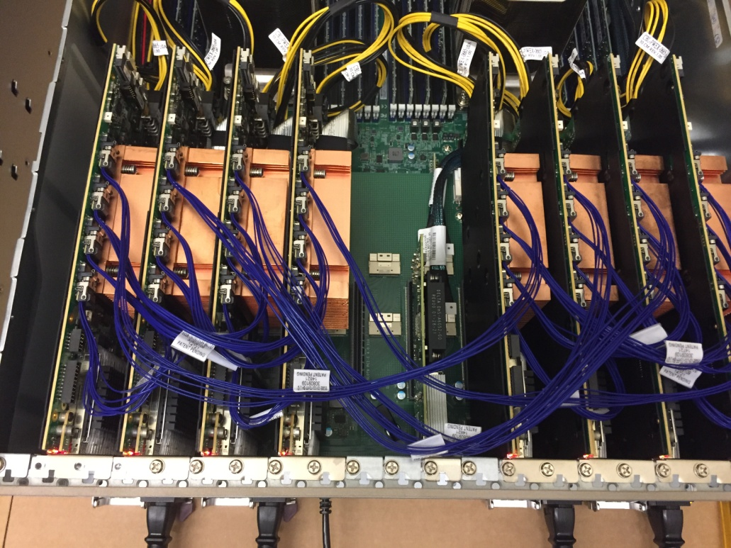
Server external and internal 100Gbps connections
One of 4 QSFP28 per FPGA
Firefly cables: 4 twinaxial each direction

Slide 9
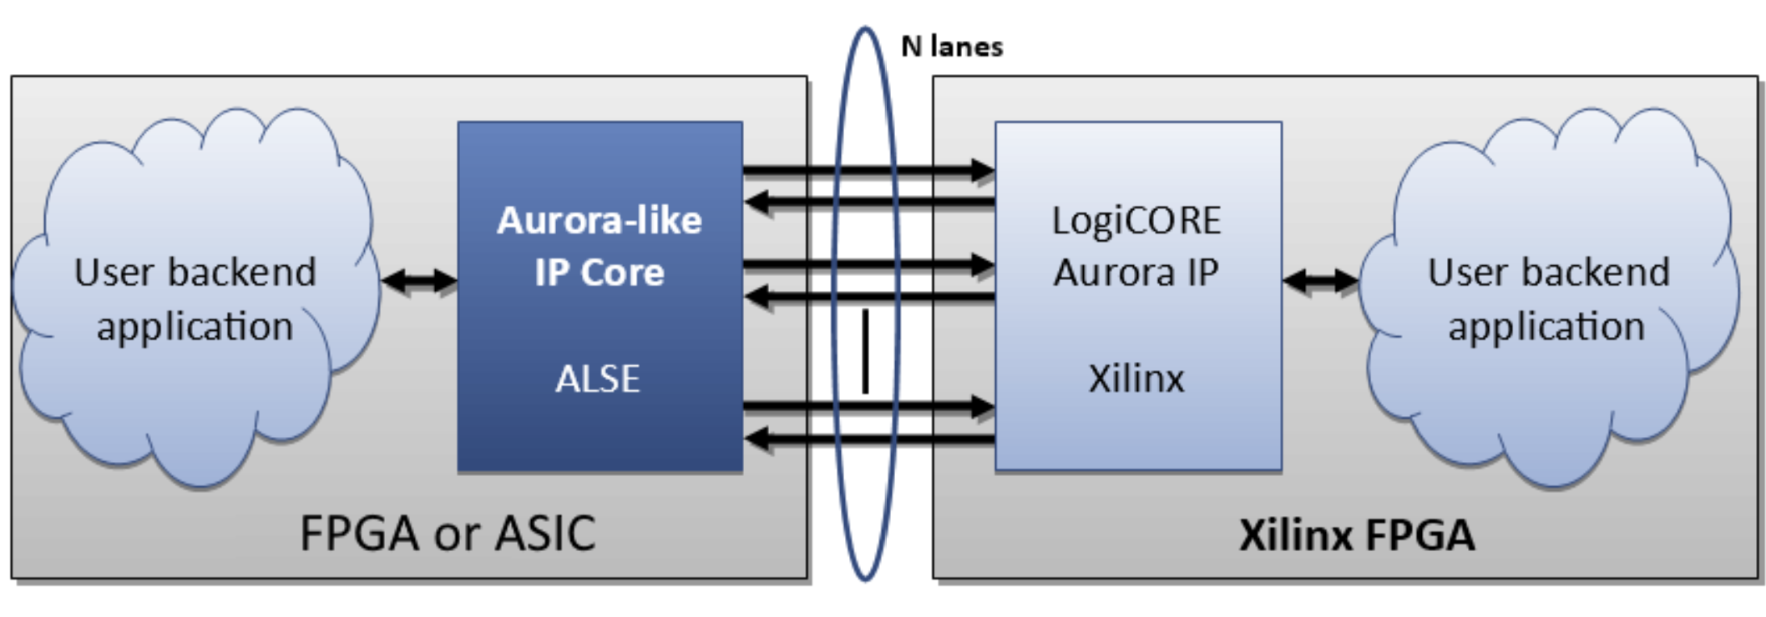
FPGA-FPGA Data Communication through Aurora

Slide 10
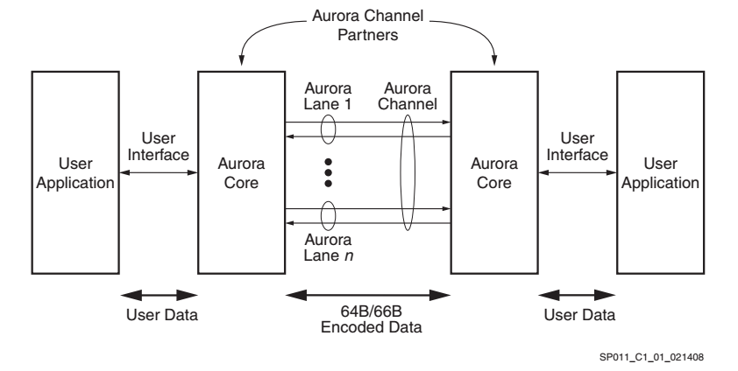
Aurora Protocol

Slide 11
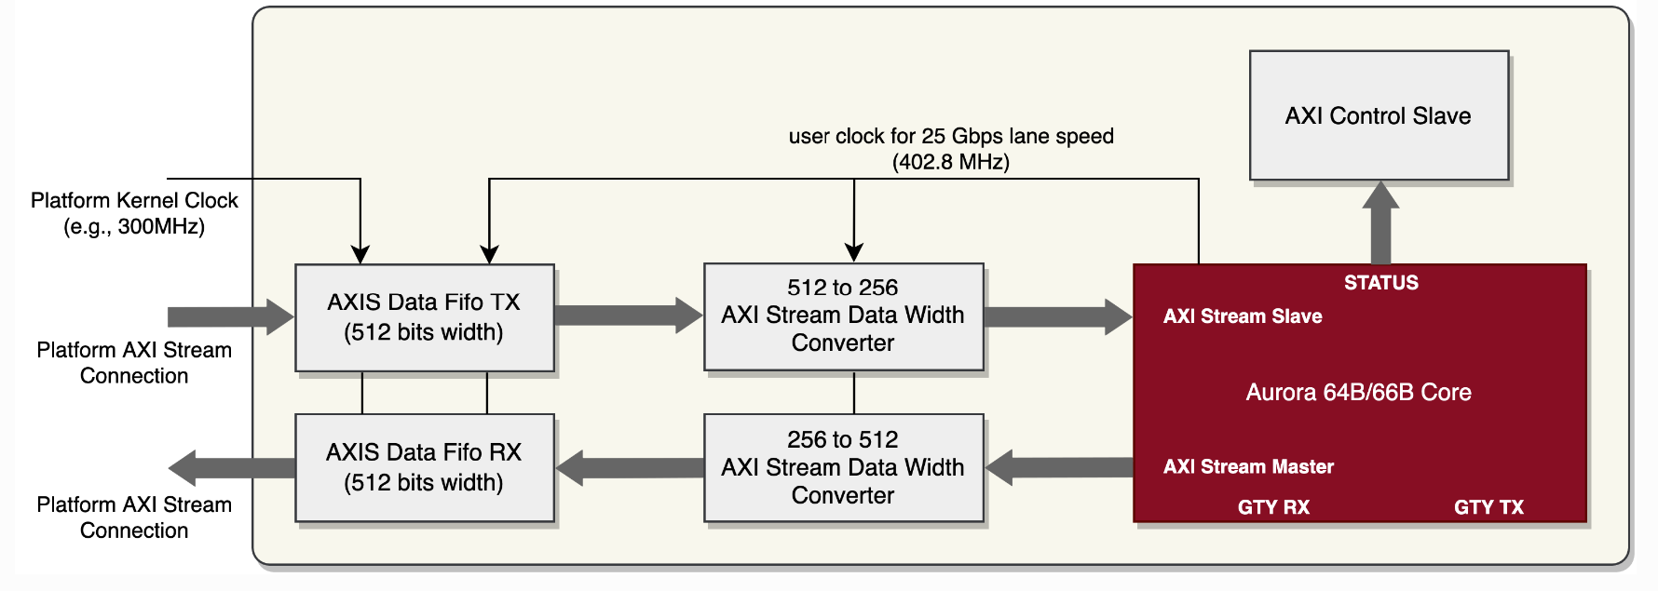
Kernel AXI Stream Data Communication

Slide 12
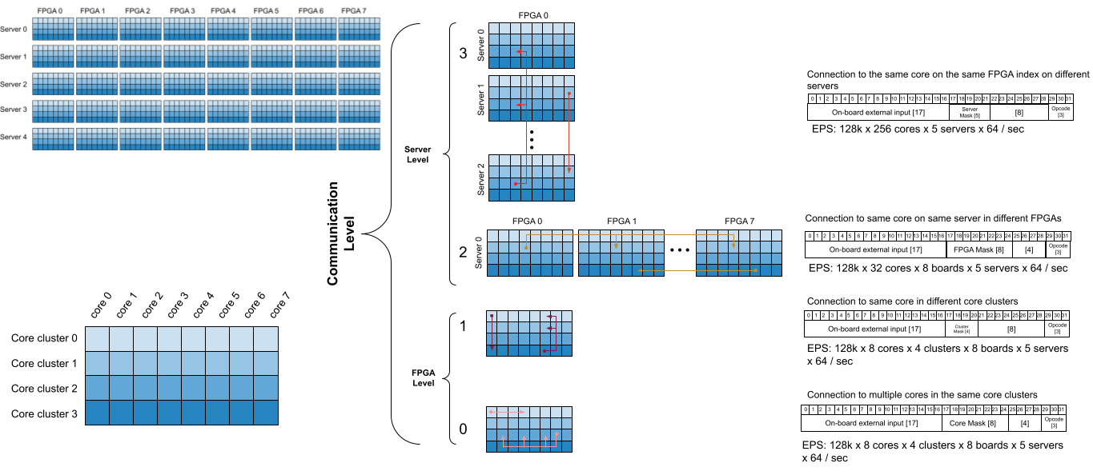
Hierarchical Routing for Camelot Architecture
"Hierarchical Address Event Routing for Reconfigurable Large-Scale Neuromorphic Systems," J. Park, T. Yu, S. Joshi, C. Maier and G. Cauwenberghs, in IEEE Transactions on Neural Networks and Learning Systems, vol. 28, no. 10, pp. 2408-2422, Oct. 2017
"Scalable Event Routing in Hierarchical Neural Array Architecture with Global Synaptic Connectivity," S. Joshi, S. Deiss, M. Arnold, J. Park, T. Yu, and G. Cauwenberghs, Proc. IEEE Int. Workshop Cellular Nanoscale Networks and Their Applications (CNNA 2010), Berkeley CA, Febr. 3-5, 2010.

Slide 13
Packet Architecture
Axonal events – 17 bits
Server mask – 3 bits
FPGA mask – 3 bits
Cluster mask – 2 bits
Core mask – 3 bits
SD |  | On-board external input |  |  |  |  |  |  |  |  |  |  |  |  |  |  |  |  |  | Server mask |  |  | FPGA mask |  |  | Cluster mask |  | Core mask
30 bit Packet transferred from between cores

Slide 14

Hierarchical Core Packet Communication
$$C_{Core−Cluster−FPGA−Server}$$

Slide 15
Firefly Interconnectivity within Servers

Slide 16
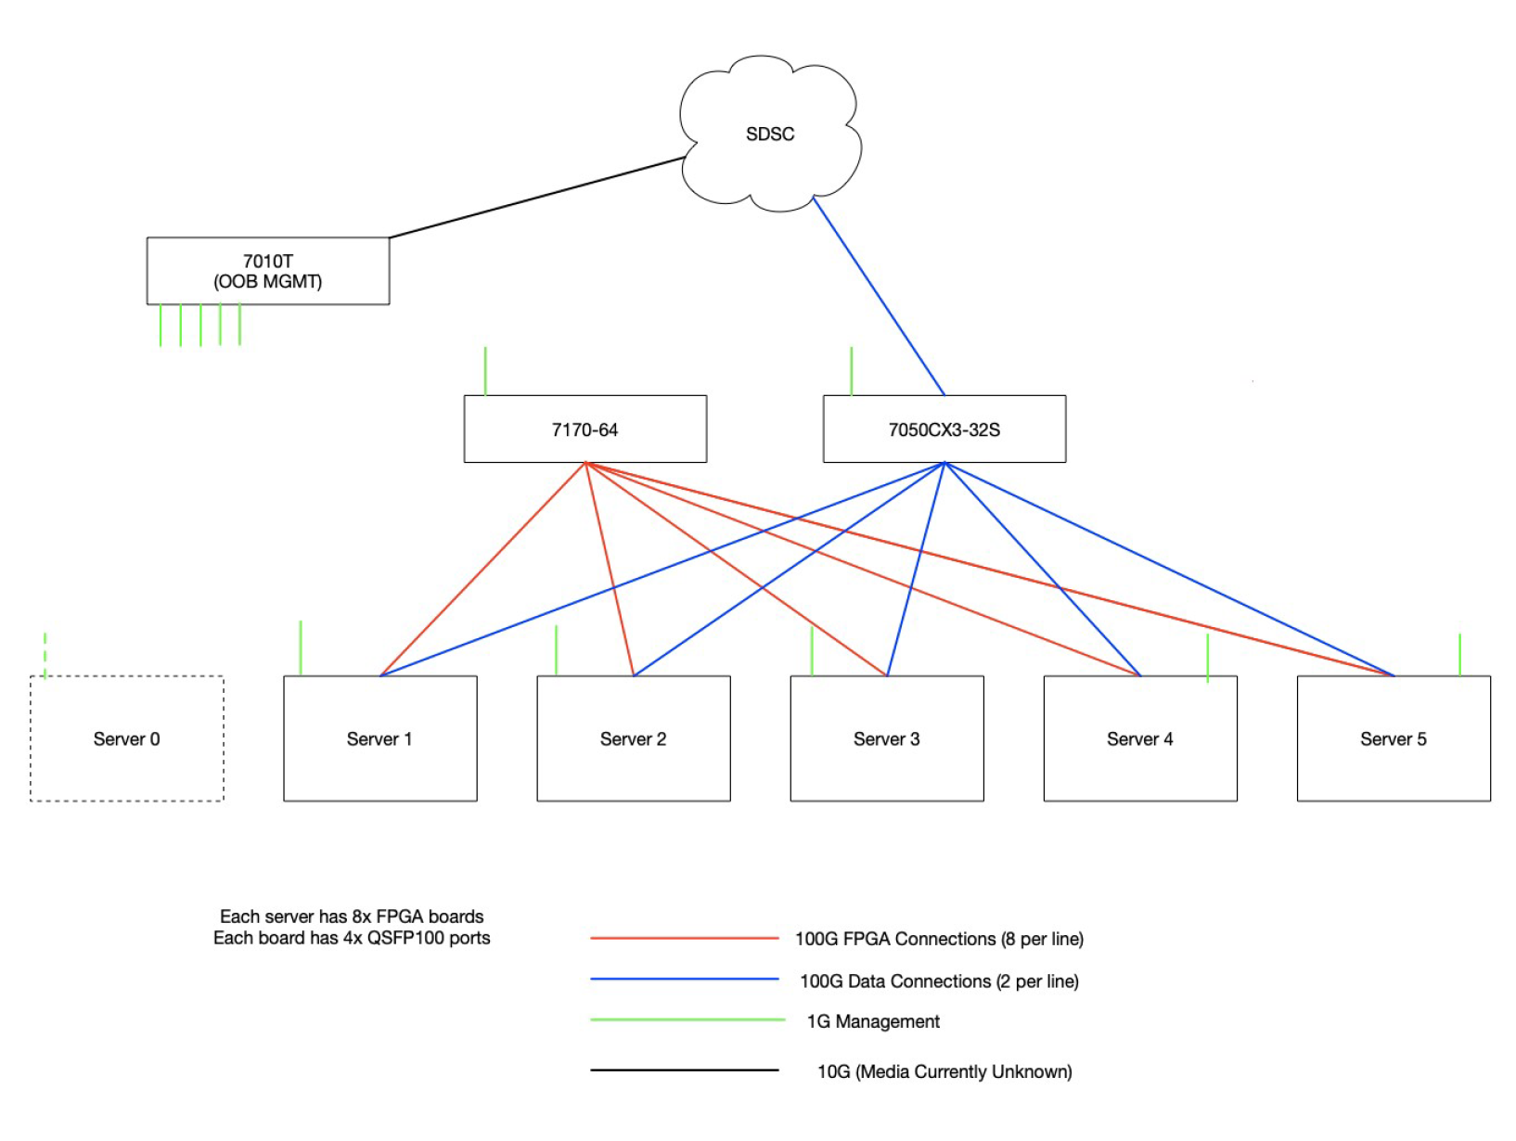
Switch Utilization
NSG
1Gbps Ethernet (IPMI)
NSG Interface
SLURM Job Control
File Sharing Control
Network Compilation
Network Partitioning
Network Mapping
SW & FW Tests
P4 Programmable 100Gbps
100Gig Ethernet
Spike Processing
File Sharing
Server 0
Server 1
Server 2
Server 3
Server 4
Server 5
25 TB SSD
25 TB SSD
25 TB SSD
25 TB SSD
25 TB SSD
25 TB SSD
5 servers have 8 FPGA Boards each.
The 6th is for system & job control.
(2 per line)

Slide 17
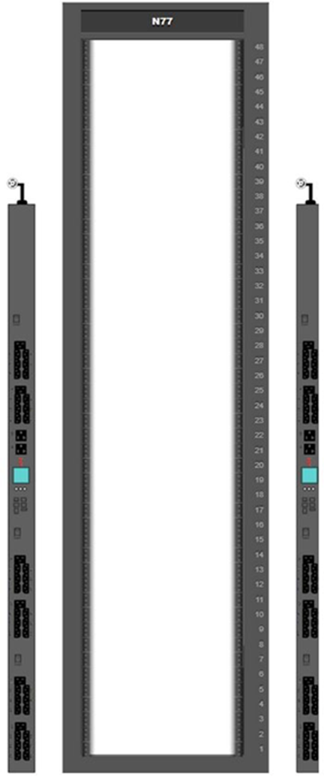
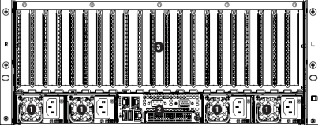
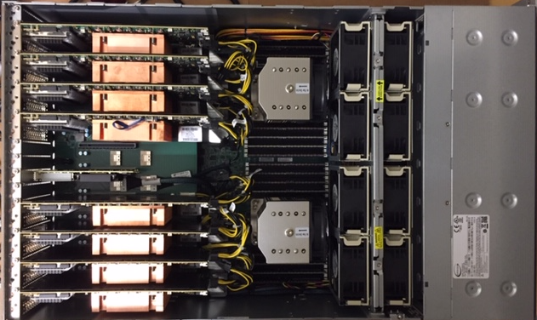
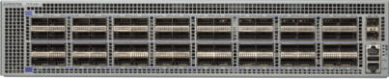
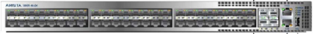
CRI Rack
1 SERVER
O77
unused space
Space for
Neurodyn
shelves
0
Server ‘0’ for
development
(add later)
1
EPYC 7502
32 core ea
All in-rack cables
are DAC 100G, SFP
or RJ45. Ext Conn.
to be determined
2
Arista
DCS-7170-64C-R
DCS-7050CX3-32SP-R
DCS-7010T-48-R
3
Servers are
SMC EPYC
AS-4124GS-TNR
1 Server of
5 for NSG
8 FPGAs
4
Server lid extension
for internal cables
5
8 ADM-PCIE-9H7
13 port USB 3.1

Slide 18
Thank you

